Slide 1

3
Discrete Random
Variables and
Probability Distributions
Copyright © Cengage Learning. All rights reserved.

Slide 2
3.6
The Poisson Probability Distribution
Copyright © Cengage Learning. All rights reserved.

Slide 3
The Poisson Probability Distribution
The binomial, hypergeometric, and negative binomial distributions were all derived by starting with an experiment consisting of trials or draws and applying the laws of
probability to various outcomes of the experiment.
There is no simple experiment on which the Poisson distribution is based, though we will shortly describe how it can be obtained by certain limiting operations.

Slide 4
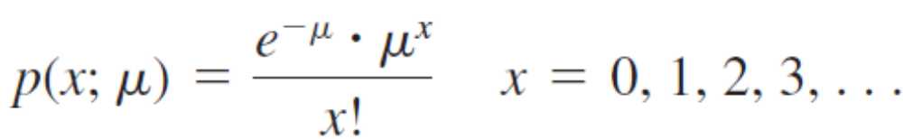
The Poisson Probability Distribution
Definition
A discrete random variable X is said to have a Poisson distribution with parameter μ (μ > 0) if the pmf of X is

Slide 5
The Poisson Probability Distribution
It is no accident that we are using the symbol μ for the Poisson parameter; we shall see shortly that μ is in fact the expected value of X.
The letter e in the pmf represents the base of the natural logarithm system; its numerical value is approximately 2.71828.
In contrast to the binomial and hypergeometric distributions, the Poisson distribution spreads probability over all non-negative integers, an infinite number of possibilities.

Slide 6
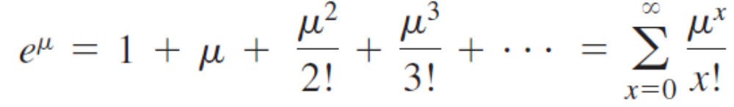
The Poisson Probability Distribution
It is not obvious by inspection that p(x; μ) specifies a legitimate pmf, let alone that this distribution is useful.
First of all, p(x; μ) > 0 for every possible x value because of the requirement that μ > 0.
The fact that Σ p(x; μ) = 1 is a consequence of the Maclaurin series expansion of e^{μ} (check your calculus book for this result):
(3.18)

Slide 7
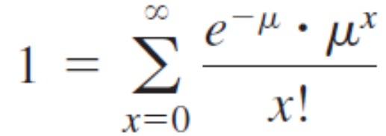
The Poisson Probability Distribution
If the two extreme terms in (3.18) are multiplied by e^{–μ} and then this quantity is moved inside the summation on the far right, the result is

Slide 8

Example 39
Let X denote the number of creatures of a particular type captured in a trap during a given time period.
Suppose that X has a Poisson distribution with μ = 4.5, so on average traps will contain 4.5 creatures.
The probability that a trap contains exactly five creatures is

Slide 9



Example 39
cont’d
The probability that a trap has at most five creatures is

Slide 10
The Poisson Distribution as a
Limit

Slide 11

The Poisson Distribution as a Limit
The rationale for using the Poisson distribution in many
situations is provided by the following proposition.
Proposition
Suppose that in the binomial pmf b(x; n, p), we let n → and p → 0 in such a way that np approaches a value μ > 0. Then b(x; n, p) → p(x; μ).
According to this proposition, in any binomial experiment in which n is large and p is small, b(x; n, p) ≈ p(x; μ), where
μ = np. As a rule of thumb, this approximation can safely be applied if n > 50 and np < 5.

Slide 12
Example 40
If a publisher of nontechnical books takes great pains to ensure that its books are free of typographical errors, so that the probability of any given page containing at least
one such error is .005 and errors are independent from page to page, what is the probability that one of its
400-page novels will contain exactly one page with errors? At most three pages with errors?
With S denoting a page containing at least one error and F an error-free page, the number X of pages containing
at least one error is a binomial rv with n = 400 and p = .005, so np = 2.

Slide 13
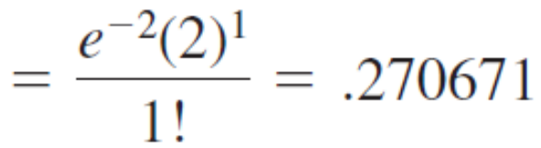
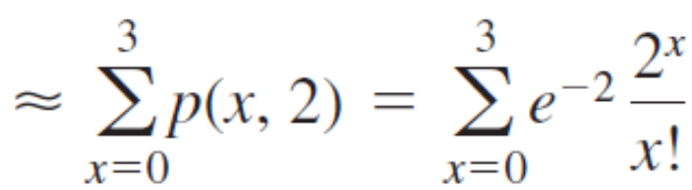
Example 40
cont’d
We wish
P(X = 1) = b(1; 400, .005) ≈ p(1; 2)
The binomial value is b(1; 400, .005) = .270669, so the approximation is very good.
Similarly,
P(X ≤ 3)

Slide 14
Example 40
cont’d
= .135335 + .270671 + .270671 + .180447
= .8571
and this again is quite close to the binomial value
P(X ≤ 3) = .8576

Slide 15
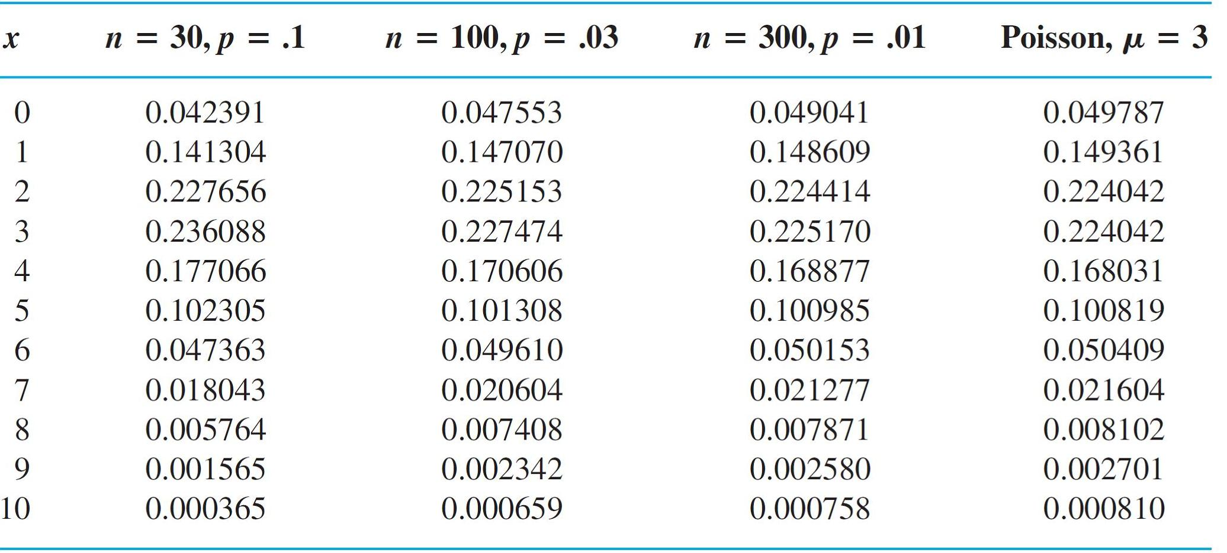
The Poisson Distribution as a Limit
Table 3.2 shows the Poisson distribution for μ = 3 along
with three binomial distributions with np = 3, and Figure 3.8
(from S-Plus) plots the Poisson along with the first two
binomial distributions.
Comparing the Poisson and Three Binomial Distributions
Table 3.2

Slide 16
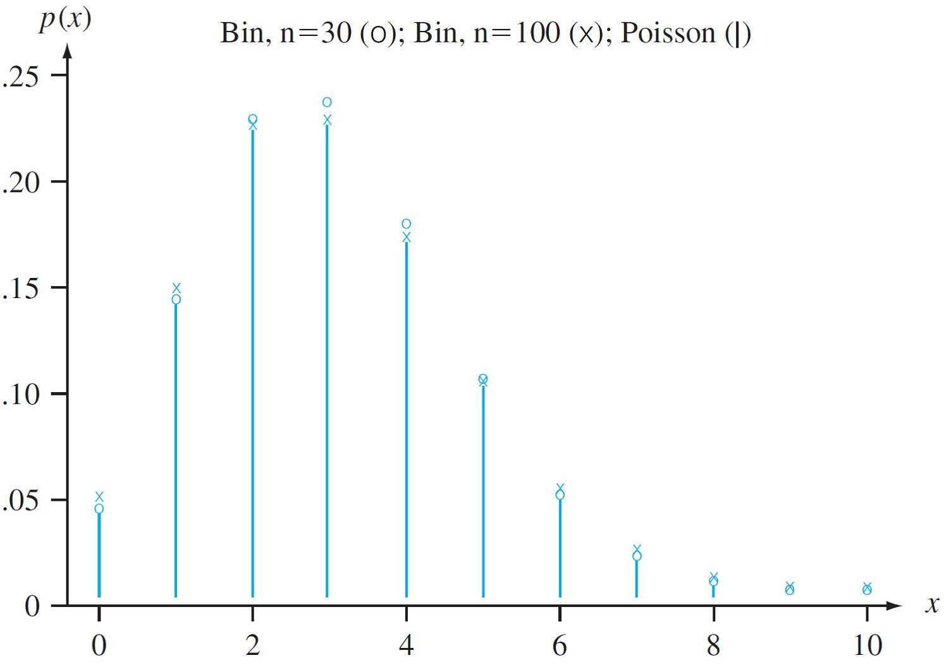
The Poisson Distribution as a Limit
The approximation is of limited use for n = 30, but of course the accuracy is better for n = 100 and much better for
n = 300.
Comparing a Poisson and two binomial distributions
Figure 3.8

Slide 17
The Poisson Distribution as a Limit
Appendix Table A.2 exhibits the cdf F(x; μ) for
μ = .1, .2, . . . ,1, 2, . . . , 10, 15, and 20.
For example, if μ = 2, then P(X ≤ 3) = F(3; 2) = .857 as in example 40, whereas P(X = 3) = F(3; 2) – F(2; 2) = .180.
Alternatively, many statistical computer packages will generate p(x; μ) and F(x; μ) upon request.

Slide 18
The Mean and Variance of X

Slide 19
The Mean and Variance of X
Since b(x; n, p) → p(x; μ) as n → , p → 0, np → μ, the mean and variance of a binomial variable should approach those of a Poisson variable. These limits are np → μ and np(1 – p) → μ.
Proposition
If X has a Poisson distribution with parameter μ, then
E(X) = V(X) = μ.
These results can also be derived directly from the definitions of mean and variance.

Slide 20

Example 41
Example 39 continued…
Both the expected number of creatures trapped and the variance of the number trapped equal 4.5, and
σ_{X} =
= 2.12.

Slide 21
The Poisson Process

Slide 22
The Poisson Process
A very important application of the Poisson distribution arises in connection with the occurrence of events of some type over time.
Events of interest might be visits to a particular website, pulses of some sort recorded by a counter, email messages sent to a particular address, accidents in an industrial facility, or cosmic ray showers observed by astronomers at a particular observatory.

Slide 23
The Poisson Process
We make the following assumptions about the way in which the events of interest occur:
1. There exists a parameter α > 0 such that for any short
time interval of length Δt, the probability that exactly one
event occurs is α  Δt + o(Δt.)*
2. The probability of more than one event occurring during
Δt is o(Δt) [which, along with Assumption 1, implies that
the probability of no events during Δt is 1 – α  Δt – o(Δt)]
3. The number of events occurring during the time interval
Δt is independent of the number that occur prior to this
time interval.

Slide 24
The Poisson Process
Informally, Assumption 1 says that for a short interval of time, the probability of a single event occurring is approximately proportional to the length of the time interval,
where α is the constant of proportionality.
Now let P_{k}(t) denote the probability that k events will be observed during any particular time interval of length t.

Slide 25
The Poisson Process
Proposition
P_{k}(t) = e^{–at}  (α t)^{k}/k! so that the number of events during a time interval of length t is a Poisson rv with parameter
μ = α t. The expected number of events during any such time interval is then α t, so the expected number during
a unit interval of time is α.
The occurrence of events over time as described is called a Poisson process; the parameter α specifies the rate for the process.

Slide 26
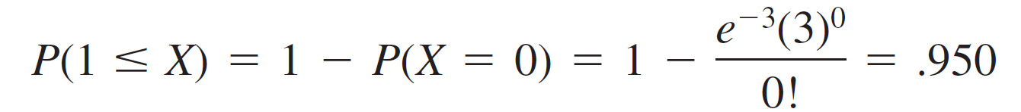
Example 42
Suppose pulses arrive at a counter at an average rate of six per minute, so that α = 6.
To find the probability that in a .5-min interval at least one pulse is received, note that the number of pulses in such an interval has a Poisson distribution with parameter
α t = 6(.5) = 3 (.5 min is used because α is expressed as a rate per minute).
Then with X = the number of pulses received in the 30-sec interval,

